Slide 1
On the Use of Routine Airborne Observations for Evaluating IASI Profile Retrievals
Timothy J. Wagner¹, Thomas August²,
Ralph A. Petersen¹
1. Cooperative Institute for Meteorological Satellite Studies
Space Science and Engineering Center
University of Wisconsin – Madison
2. EUMETSAT, Darmstadt, Germany

Slide 2
Aircraft Need in situ Data!
Pressure: Altitude of the aircraft
Wind: affects speed, efficiency
Temperature: affects engine performance, fuel consumption

Slide 3
WMO AMDAR Program
Aircraft Meteorological Data Relay
WMO program to collect temperature and wind from commercial aircraft
Aircraft already measuring this data, it just needs to be collected
Participating airlines from every WMO region
~800.000 observations per day
~15 min latency from observation to worldwide distribution

Slide 4
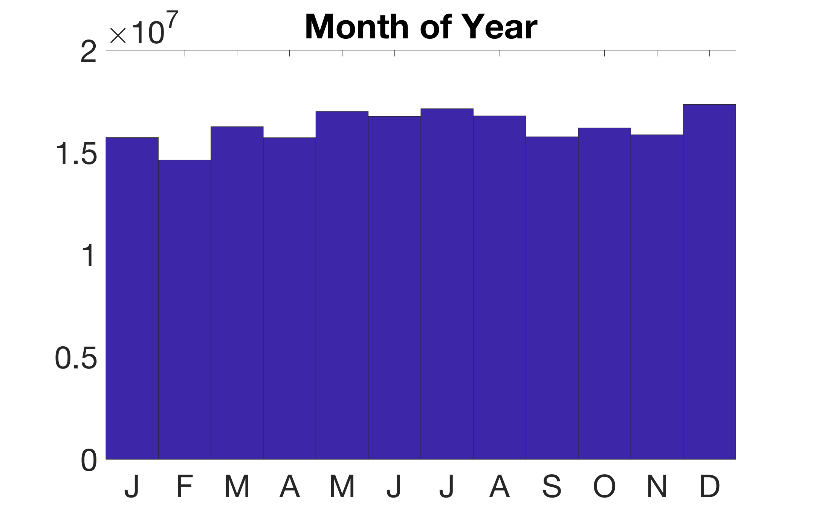
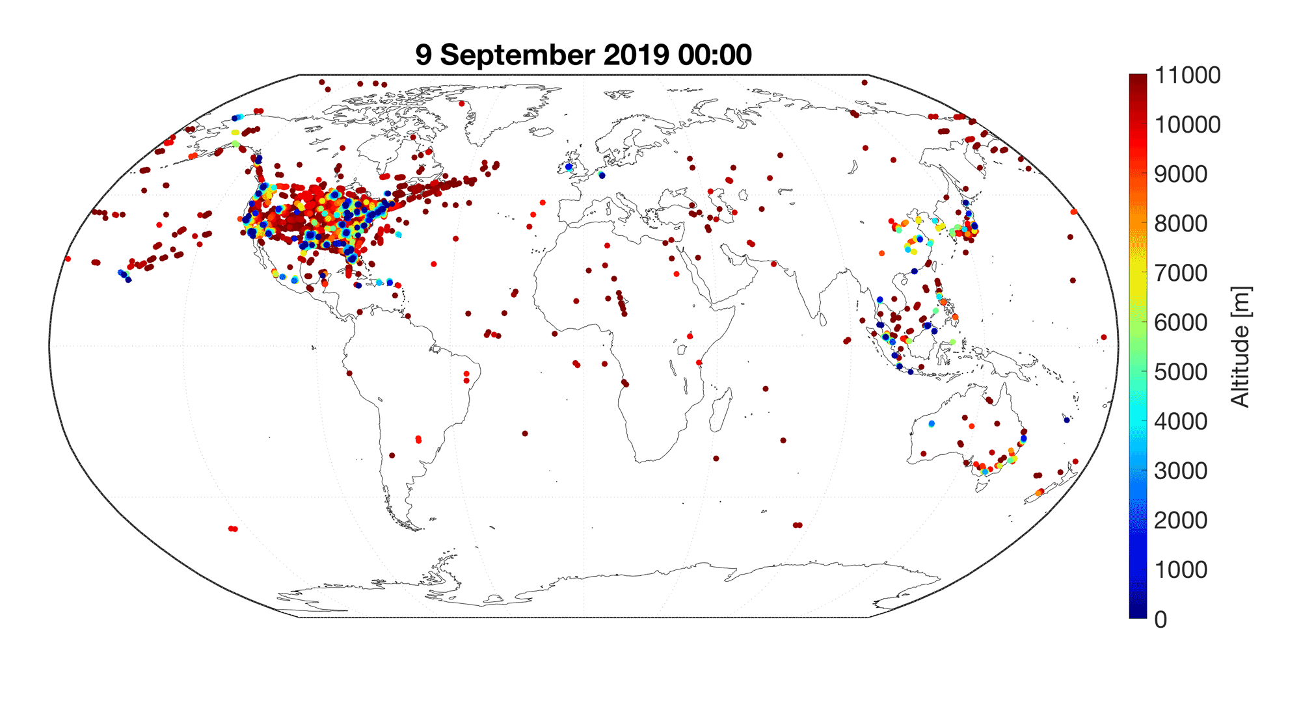
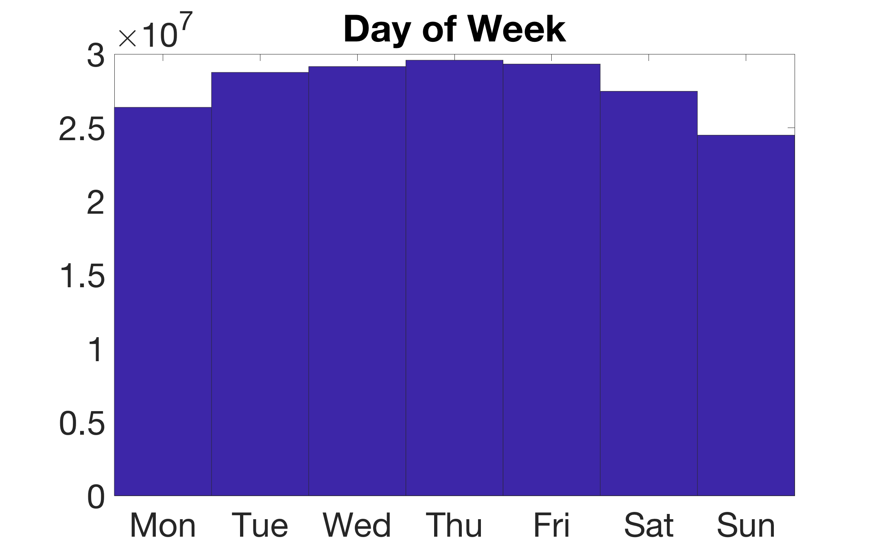
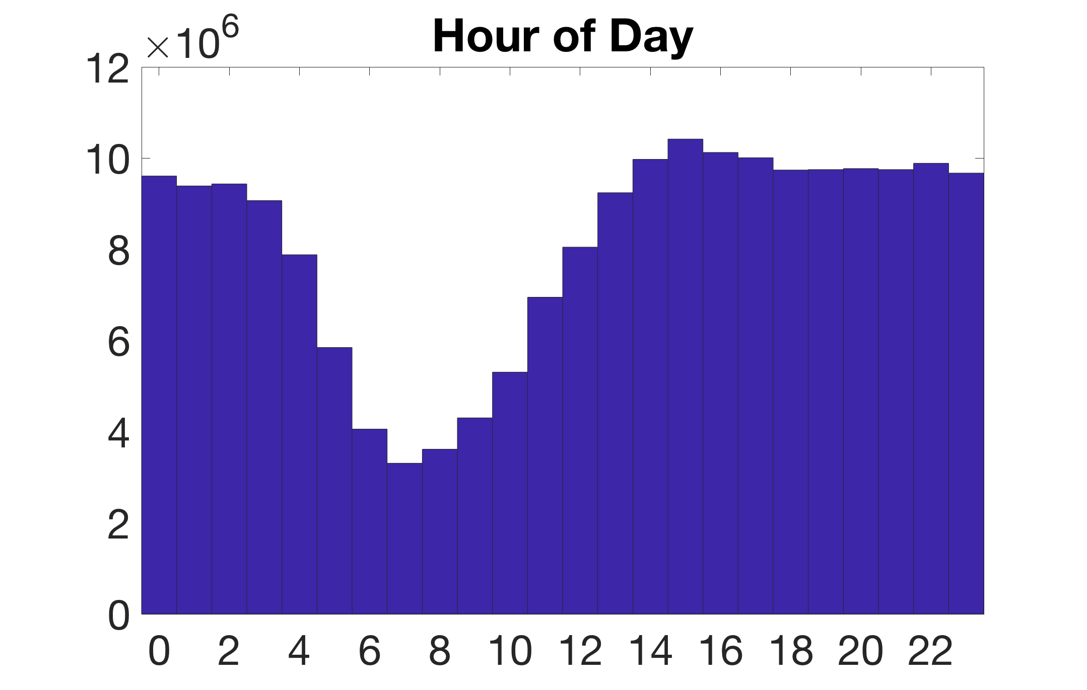

Slide 5
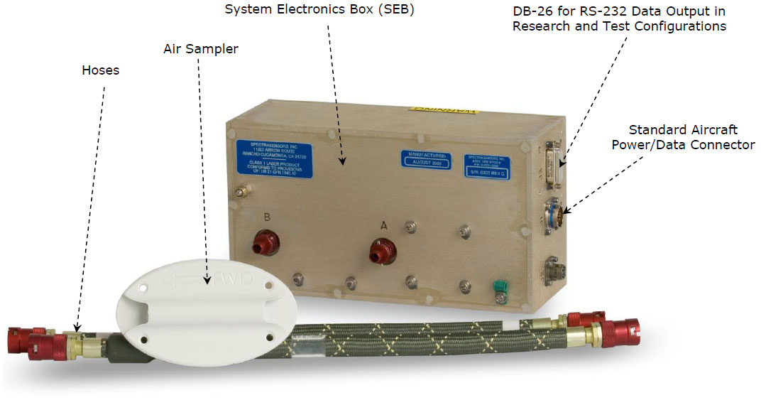
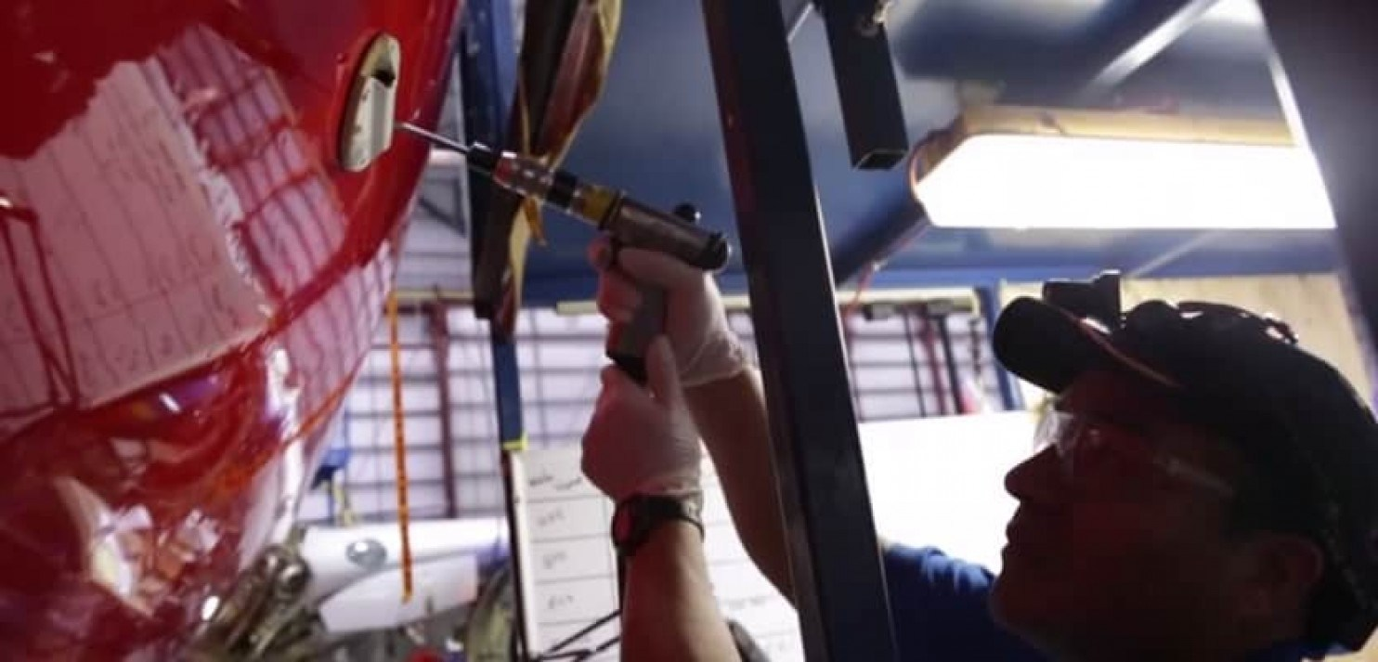
Water Vapor Sensing System - II
Laser diode directly detects water vapor molecules from absorptance
Reusable: engineered to higher standards than sondes
Approx. 120 planes in
US (UPS, Southwest)

Slide 6
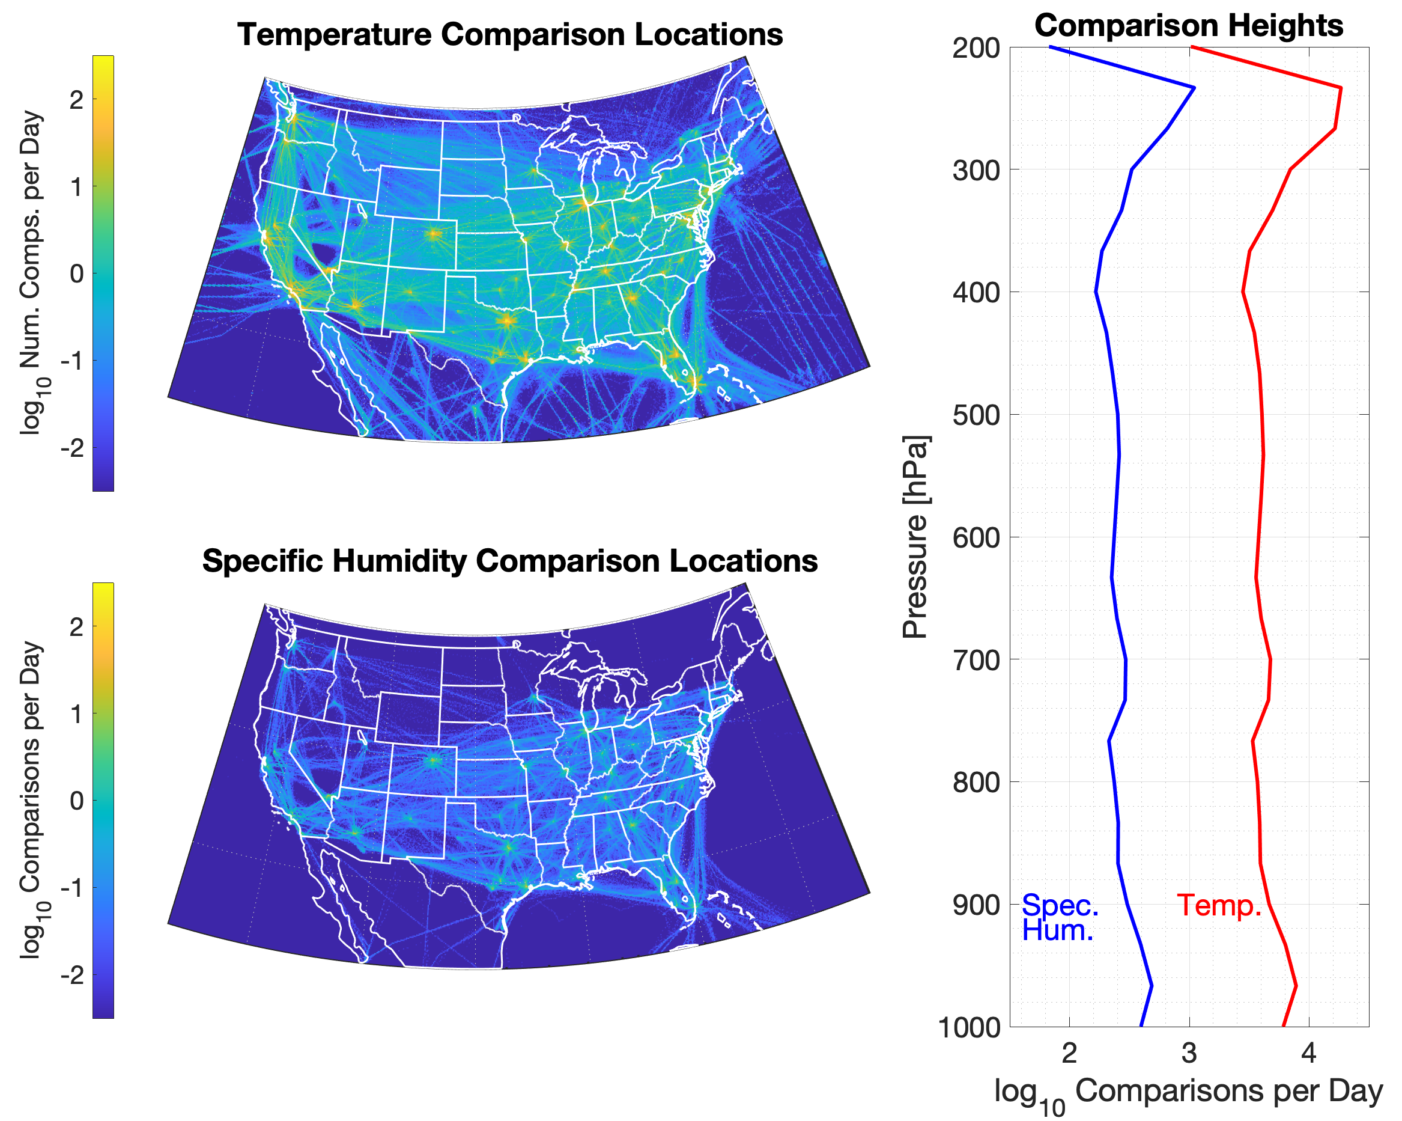
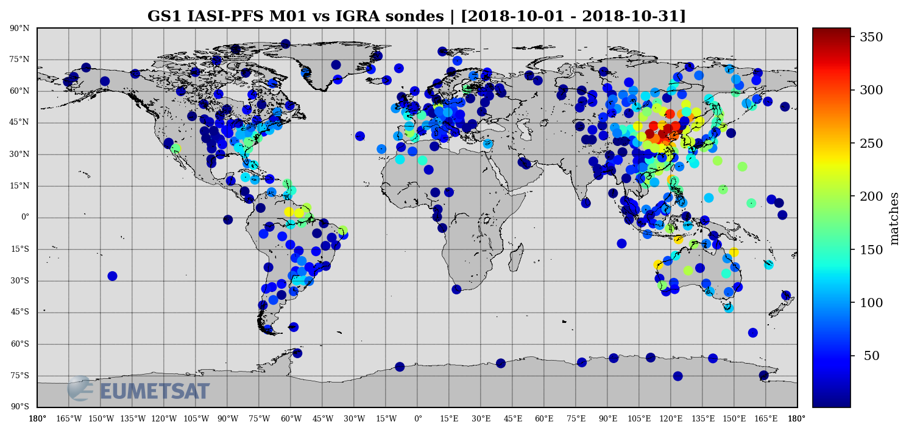
Comparing Validation Locations
AMDAR/WVSS vs. IASI
Radisonde vs. IASI
Synoptic launch schedule doesn’t always align with LEO overpasses

Slide 7
Goal and Methodology
Evaluate one year of IASI level 2 retrievals
Matching criteria:
50 km horizontally
+/- 1 hour
Vertically matched to nearest IASI level
IASI
Sonde
Plane
🛩

Slide 8
Goal and Methodology
Evaluate one year of IASI level 2 retrievals
Matching criteria:
50 km horizontally
+/- 1 hour
Vertically matched to nearest IASI level
Sonde
IASI
🛩
Plane

Slide 9
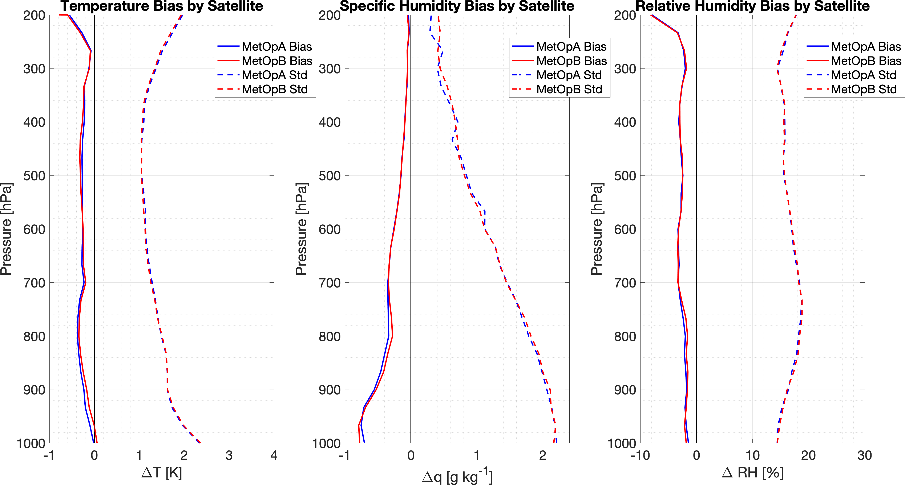
Performance Between Satellites
Conduct a year-long evaluation of IASI L2 temperature and humidity profiles across CONUS
First, evaluate the two instruments separately.
Performance is almost indistinguishable between Metop-A and Metop-B.

Slide 10
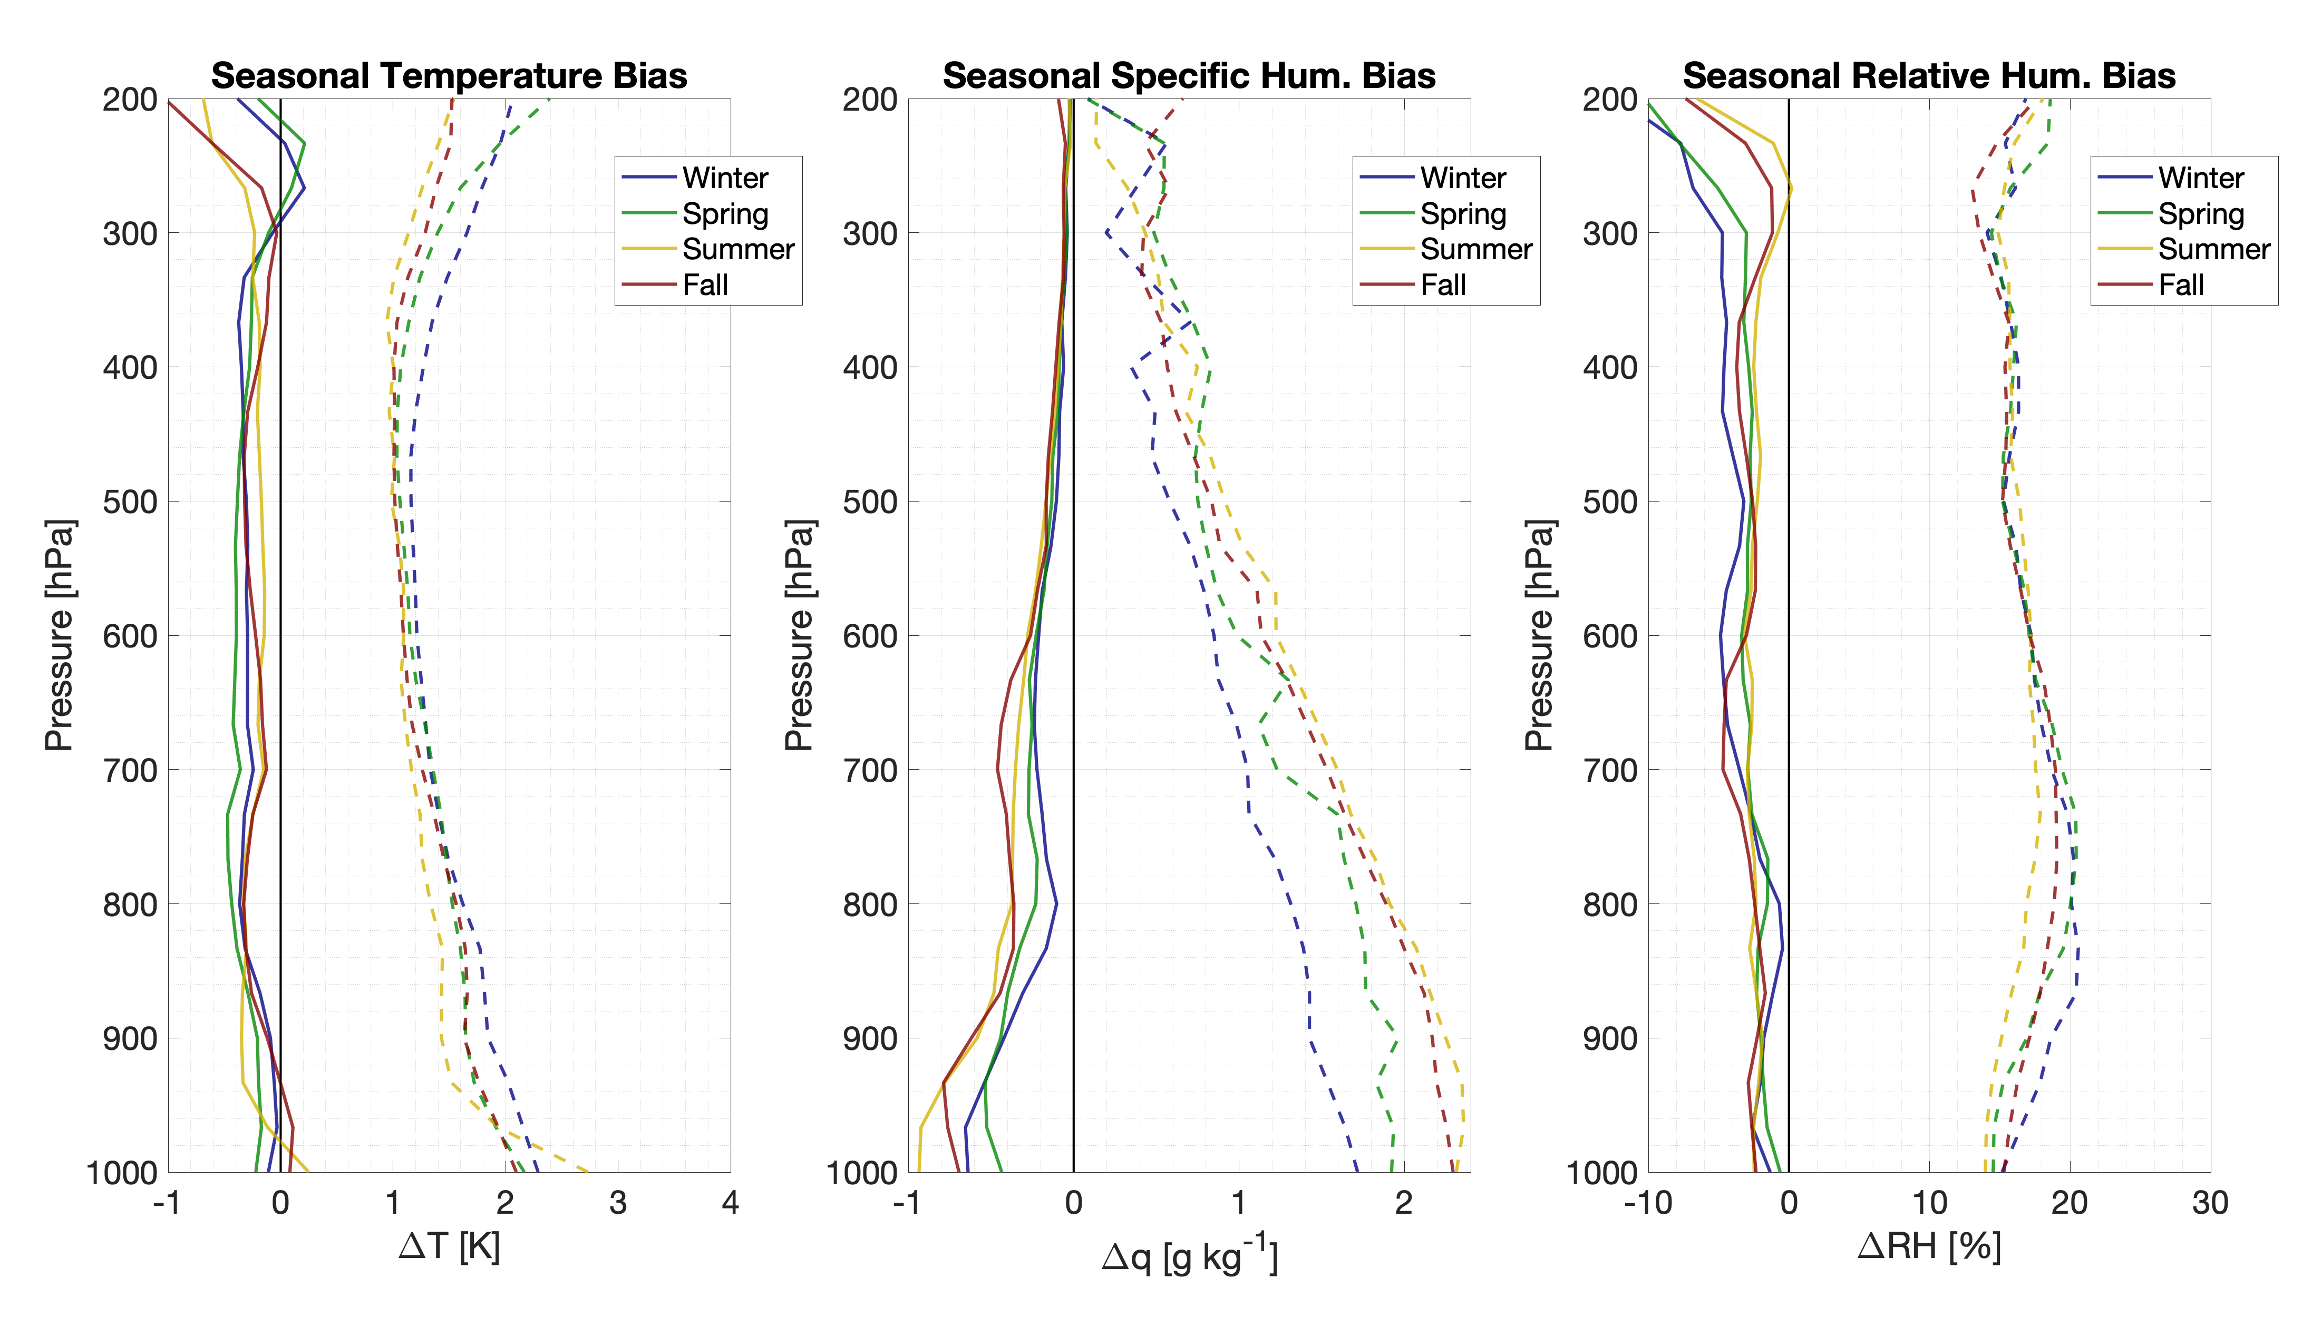
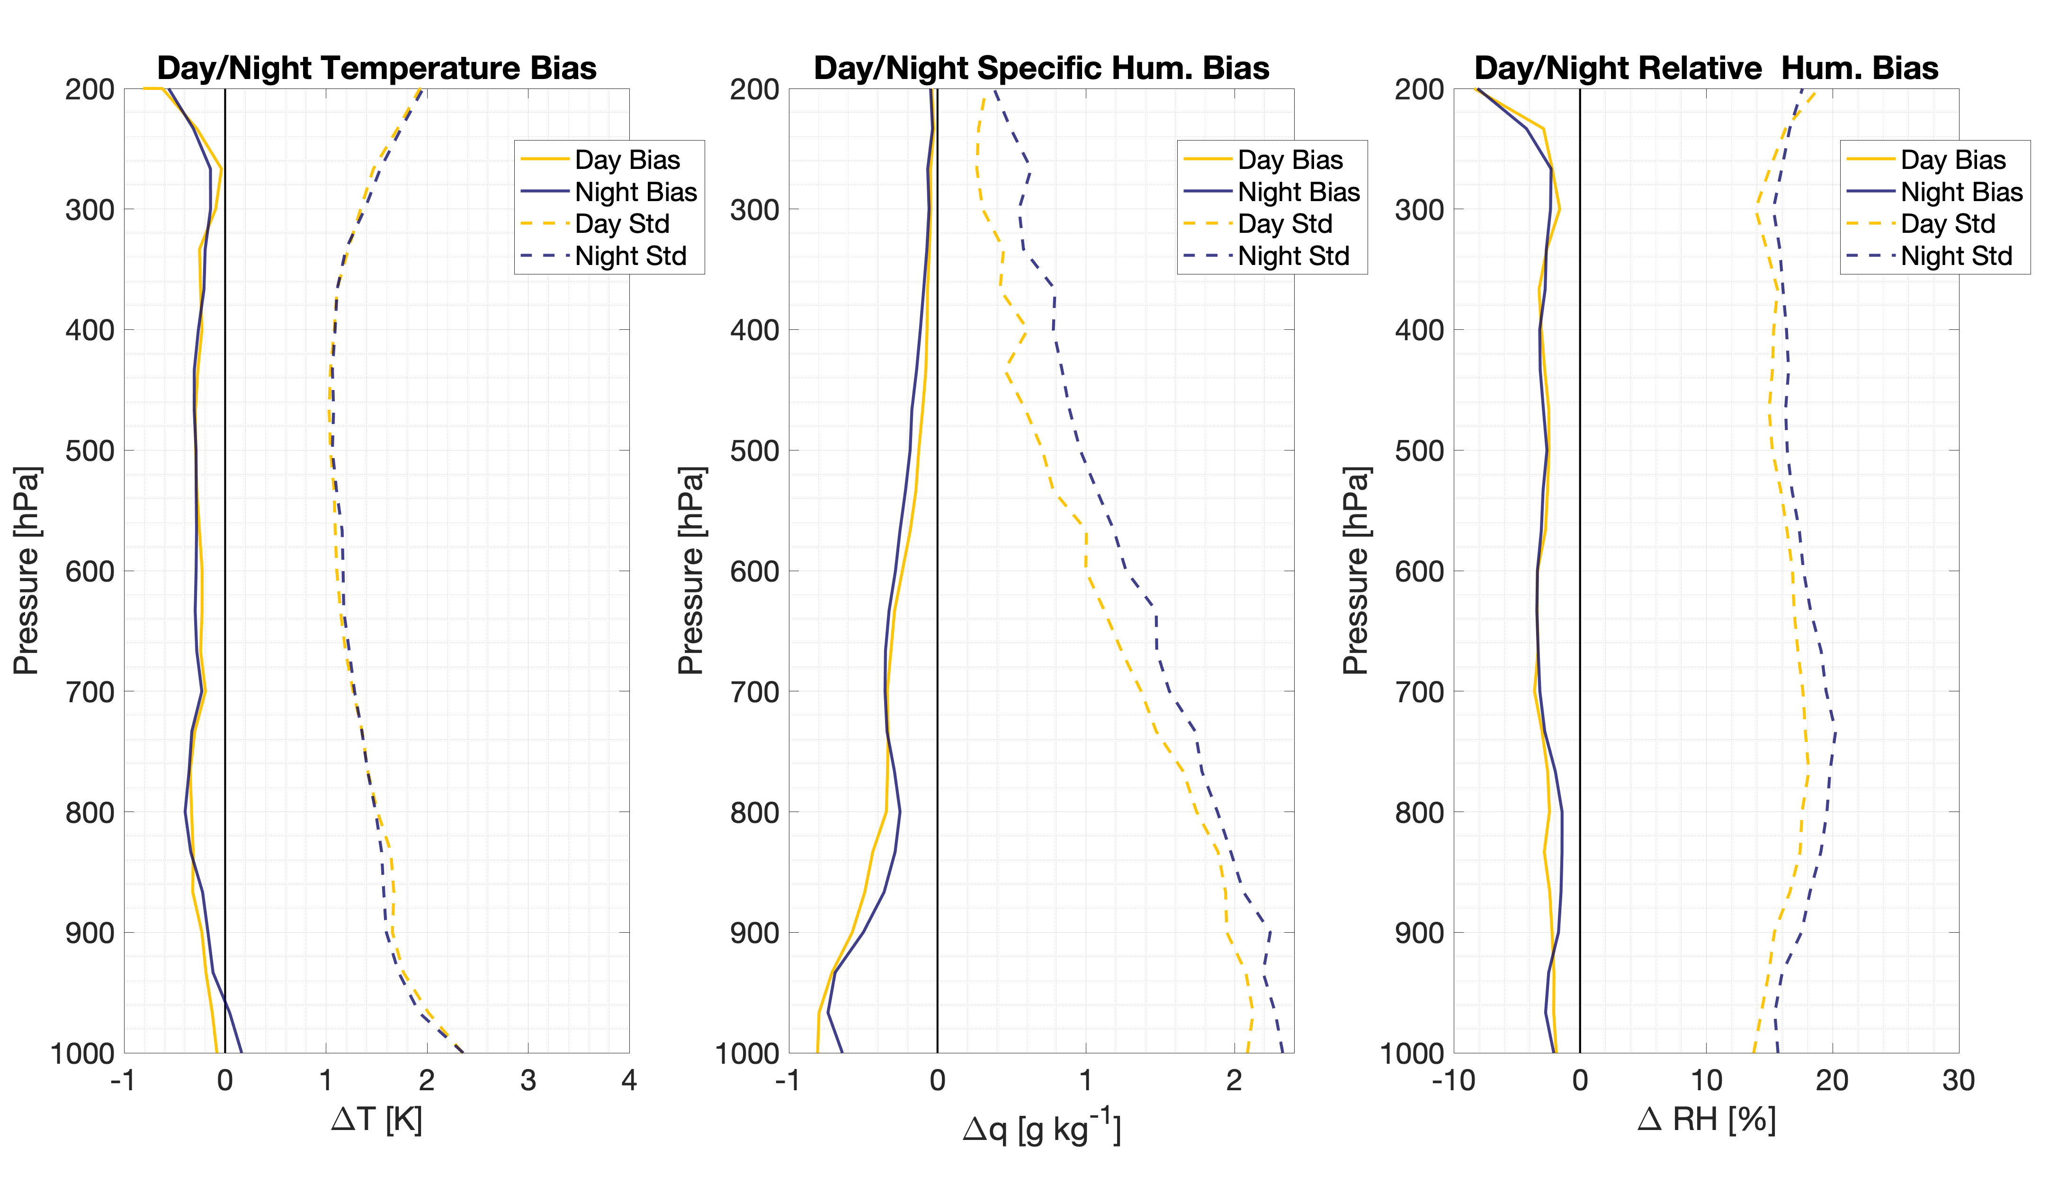
Time and Season
Temperature uncertainty least in summer, greatest in winter.
More specific humidity uncertainty during times with more vapor in air.
Temperature retrievals similar between day and night, but less specific humidity uncertainty during the day.

Slide 11
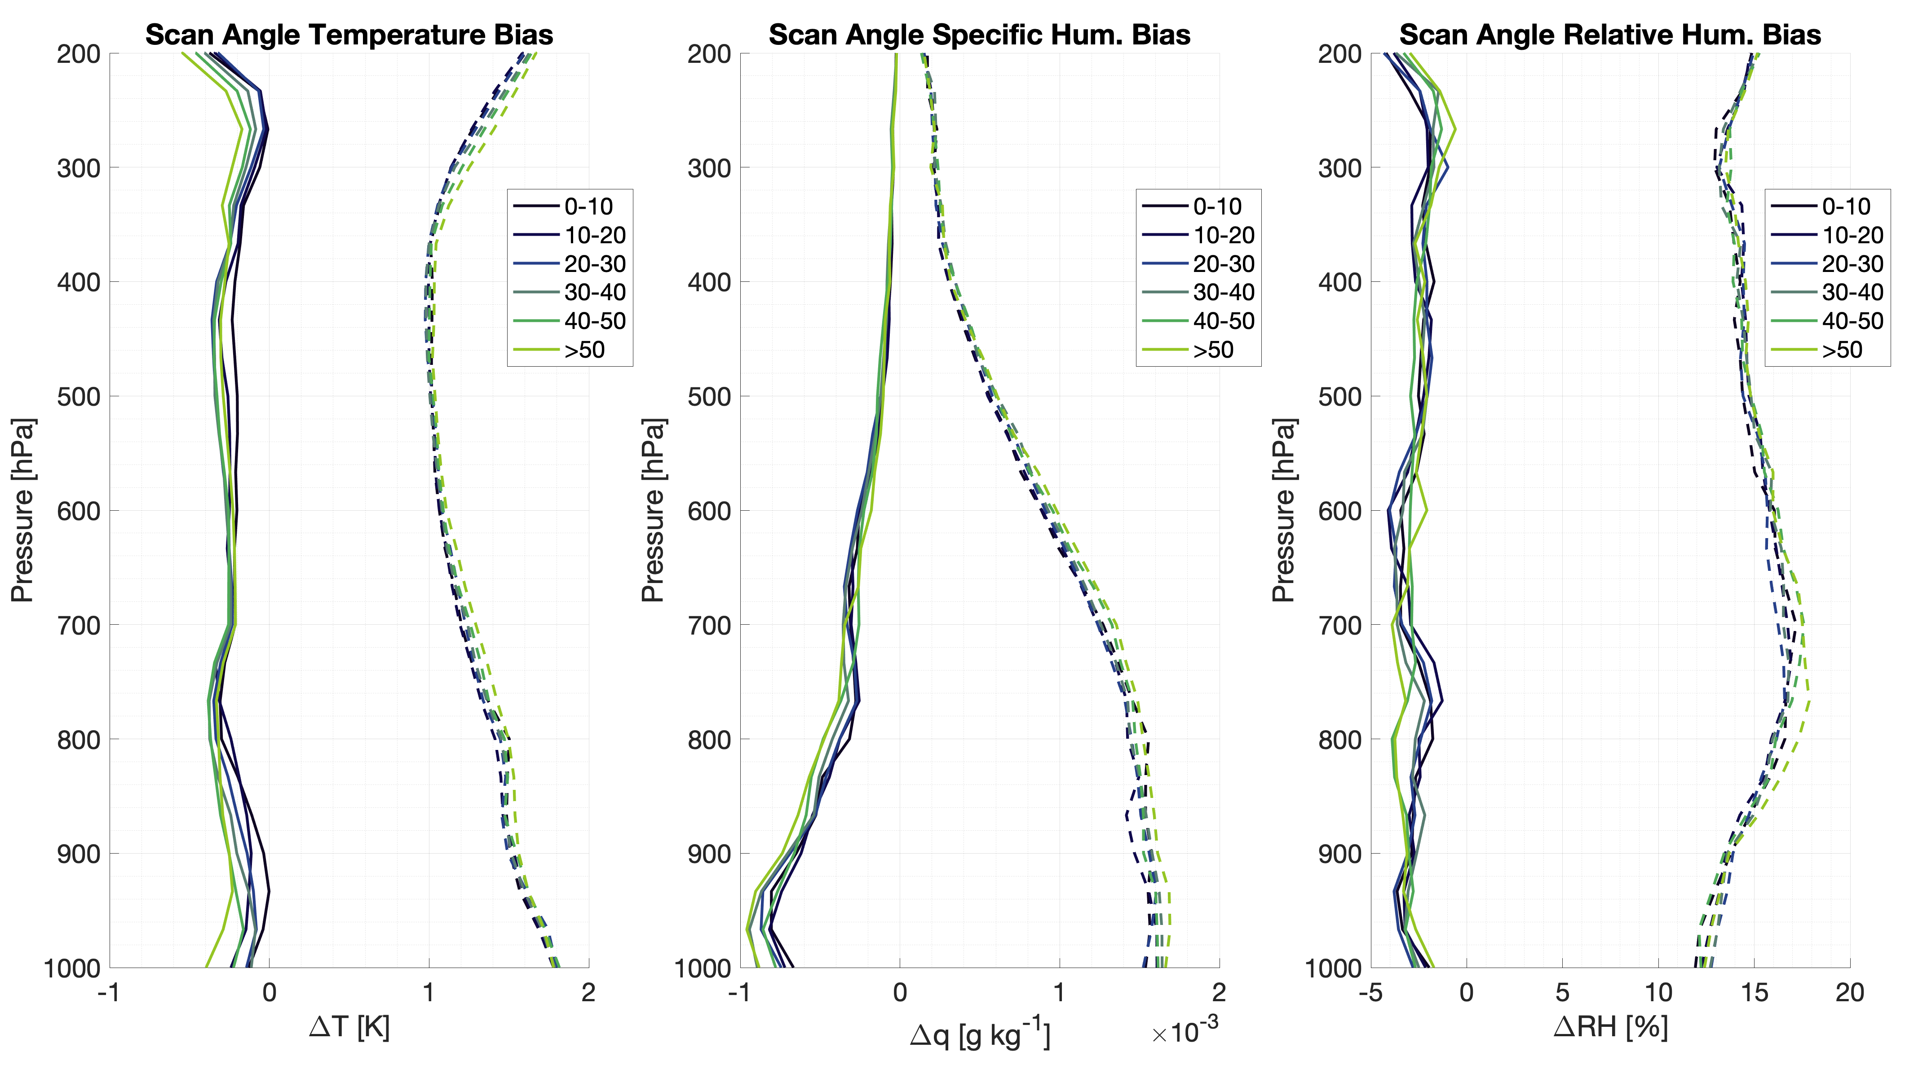
Scan Angle
With so many observations, can evaluate spatially-dependent parameters.
While differences are small, less uncertainty with smaller scan angles.

Slide 12
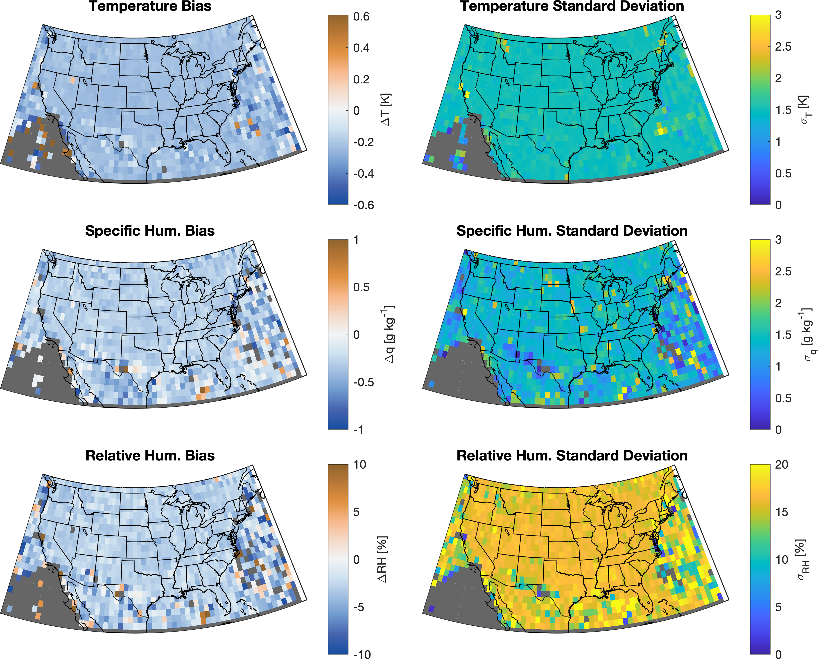
Spatial distribution of bias and uncertainty shows little latitudinal or longitudinal dependence on accuracy.
This shows how AMDAR observations combine the in situ advantages of radiosondes with the spatial availability of model output.

Slide 13
Takeaways
With near-real time transmission and validated bias correction schemes, airborne data can be used for continuous monitoring of satellite product performance.
The greater temporal and spatial density of airborne observations enables new assessments
IASI Level 2 retrievals show overall good agreement between with collocated aircraft observations, between Metop-A and Metop-B.
Increased uncertainty in IASI retrievals with increasing scan angle, at night, in the winter
tim.wagner@ssec.wisc.edu

Slide 14
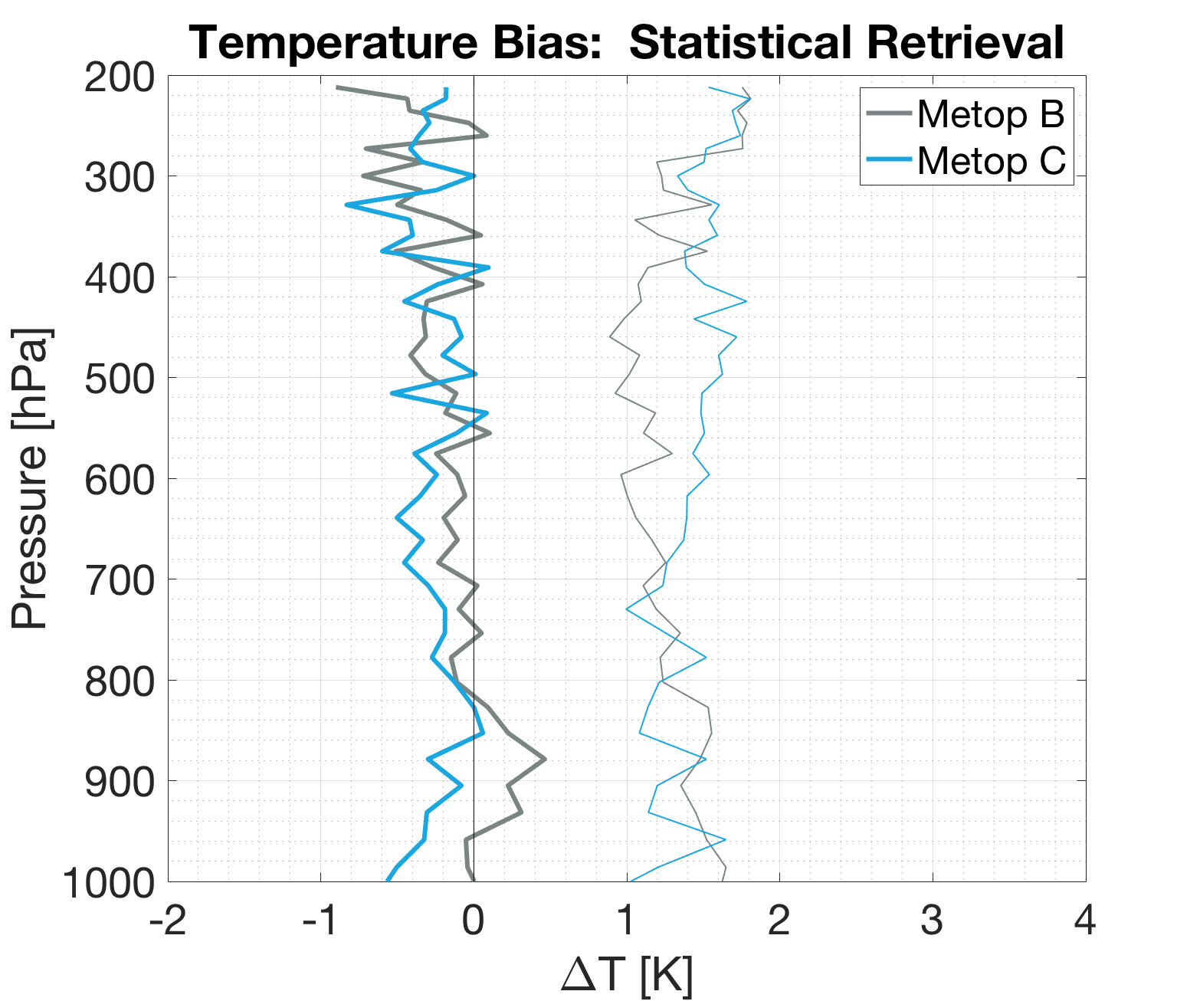
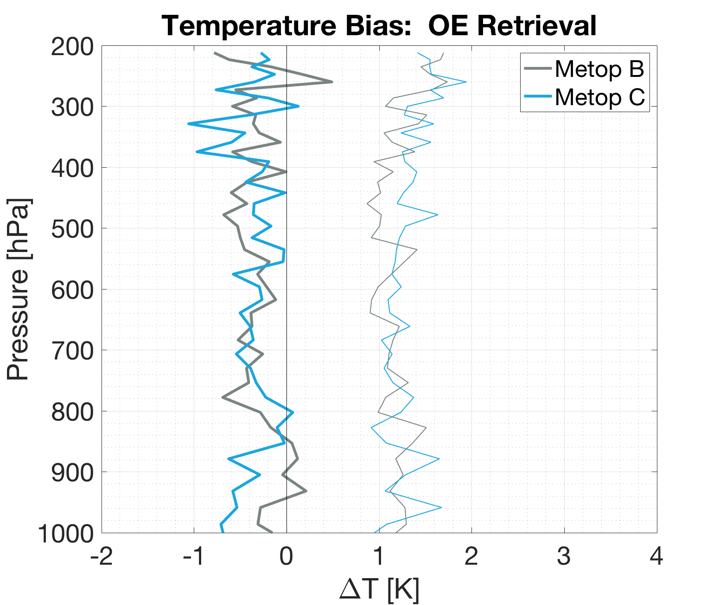
Temperature Retrievals
Bias and standard deviation profiles for both B and C compare well with AMDAR regardless of retrieval type.
OE shows some slight improvement over statistical retrieval.

Slide 15
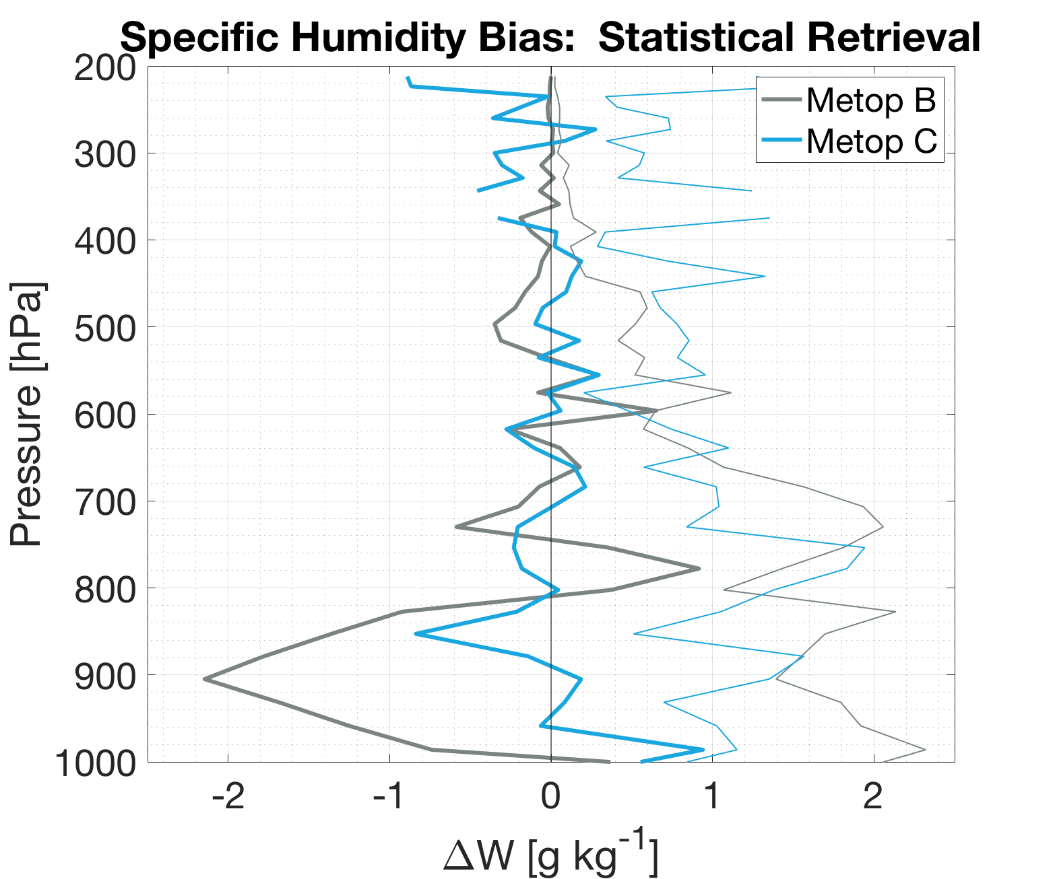
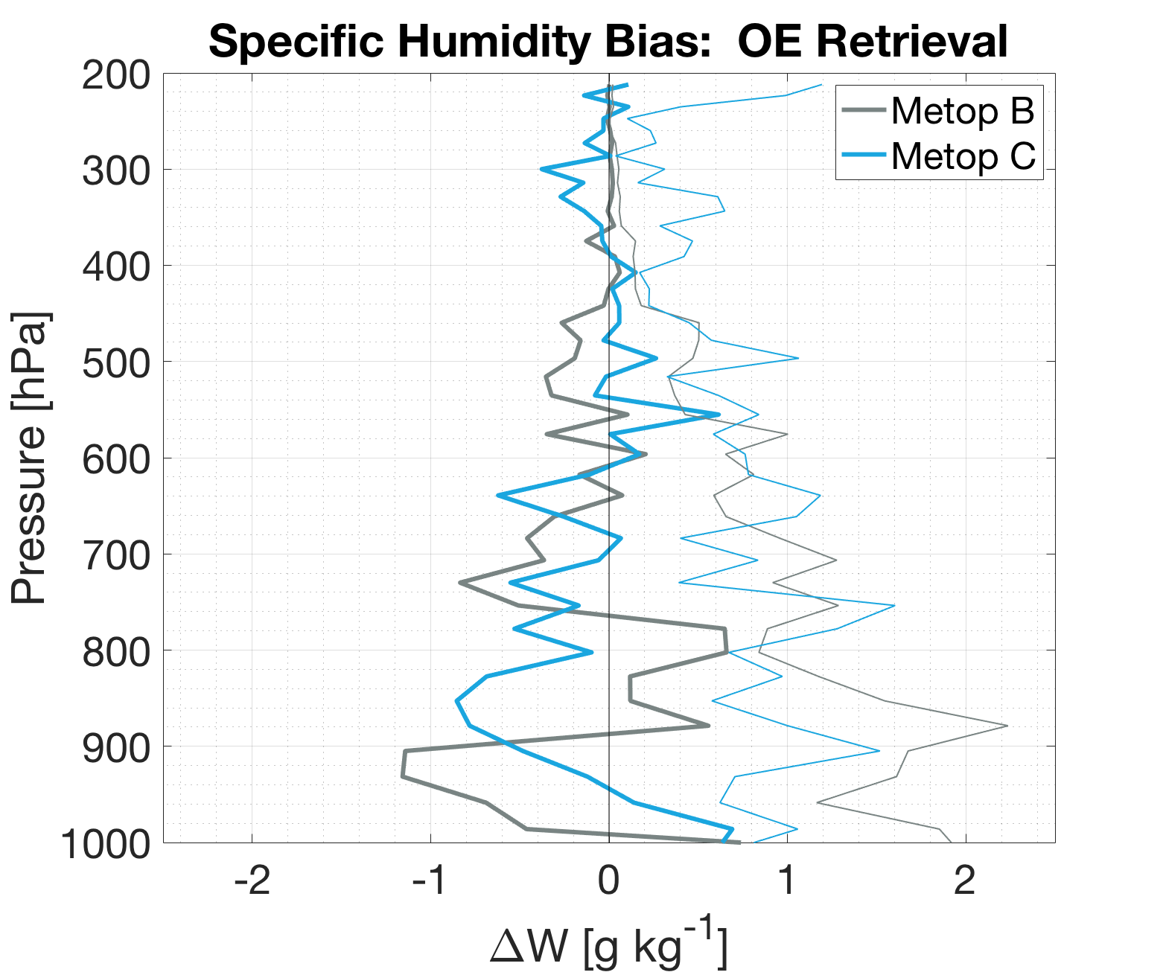
Specific Humidity Retrievals
It looks messy, but many fewer comparison points for water vapor. We expect improvement when evaluating over a longer period.
Again, OE shows improvement over statistical retrieval.

Slide 16
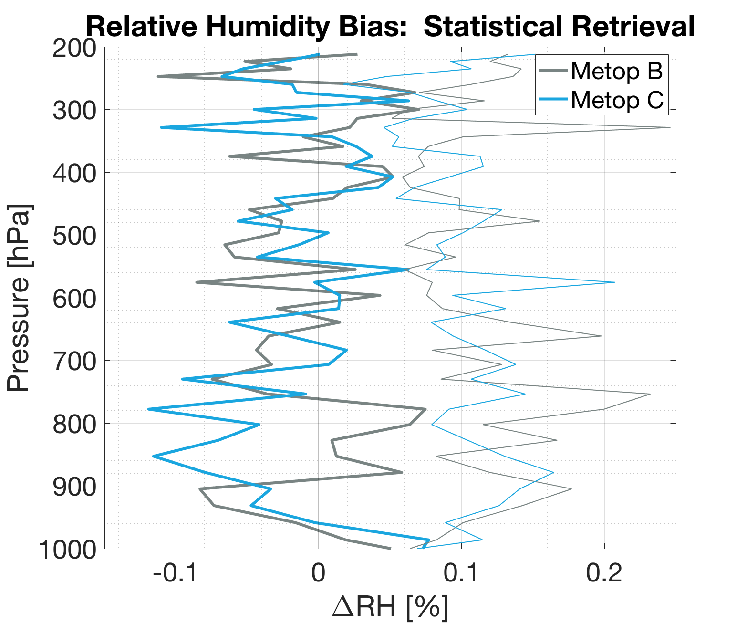
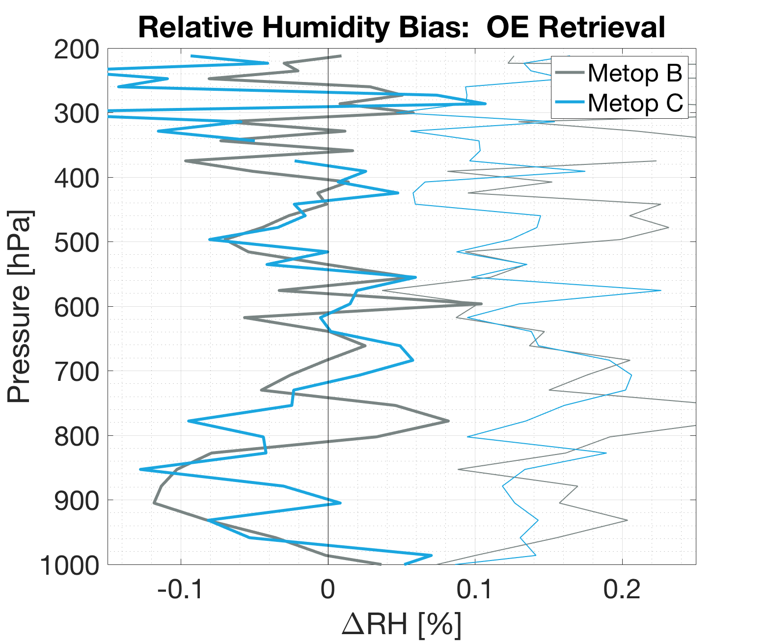
Relative Humidity Retrievals
Relative humidity combines the biases and errors of both temperature and water vapor.
As before, more observations need to be collected (or width of vertical bins needs to be reduced).

Slide 17
